Slide 1
Deep Neural Networks
Lei Qian, Ph.D.

Slide 2
Convolutional Neural Network

Slide 3
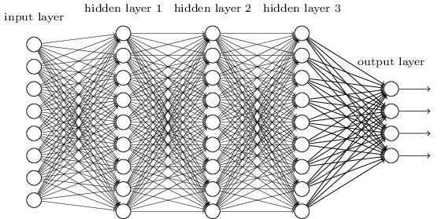
Convolutional Neural Networks
Fully connected network:
It is good to learn a small model.
How many parameters we have to learn for 1M-pixel images?
Do we really need all the edges?
Can some of these be shared?

Slide 4


Consider learning an image:
Some patterns are much smaller than the whole image
Can represent a small region with fewer parameters
“beak” detector

Slide 5

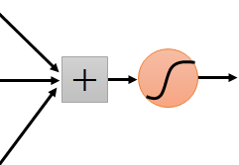
Same pattern appears in different places: They can be compressed! What about training a lot of such “small” detectors and each detector must “move around”.
“upper-left beak” detector
They can be compressed
to the same parameters.
“middle beak” detector

Slide 6
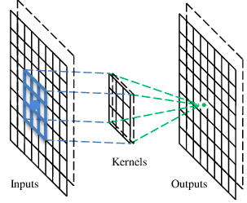
A convolutional layer
A CNN is a neural network with some convolutional layers
(and some other layers). A convolutional layer has a number
of filters that does convolutional operation.
Beak detector
A filter

Slide 7
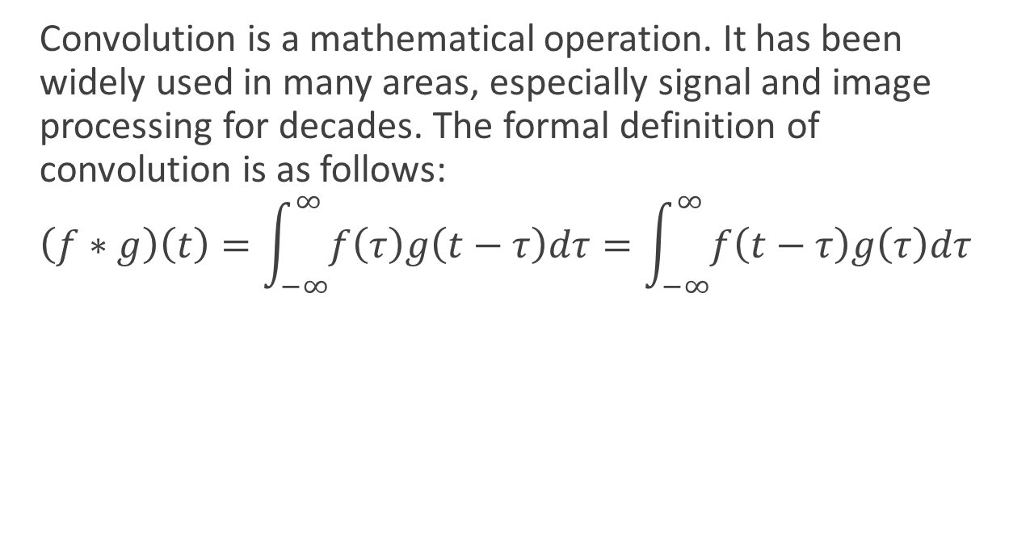
Convolution
Convolution is a mathematical operation. It has been widely used in many areas, especially signal and image processing for decades. The formal definition of convolution is as follows:
$$\left(f∗g\right)\left(t\right)=\int_{−∞}^{∞}{f\left(τ\right)g\left(t−τ\right)dτ}=\int_{−∞}^{∞}{f\left(t−τ\right)g\left(τ\right)dτ}$$

Slide 8
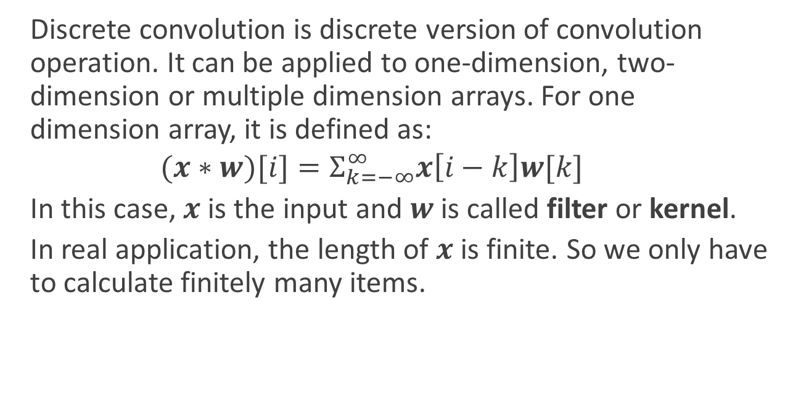
Convolution
Discrete convolution is discrete version of convolution operation. It can be applied to one-dimension, two-dimension or multiple dimension arrays. For one dimension array, it is defined as:
$$(x∗w)[i]=Σ_{k=−∞}^{∞}x\left[i−k\right]w[k]$$
In this case, $x$ is the input and $w$ is called filter or kernel.
In real application, the length of $x$ is finite. So we only have to calculate finitely many items.

Slide 9
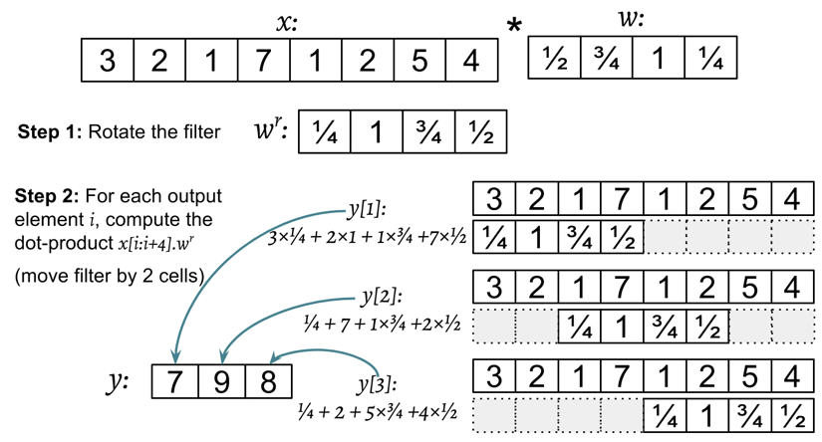
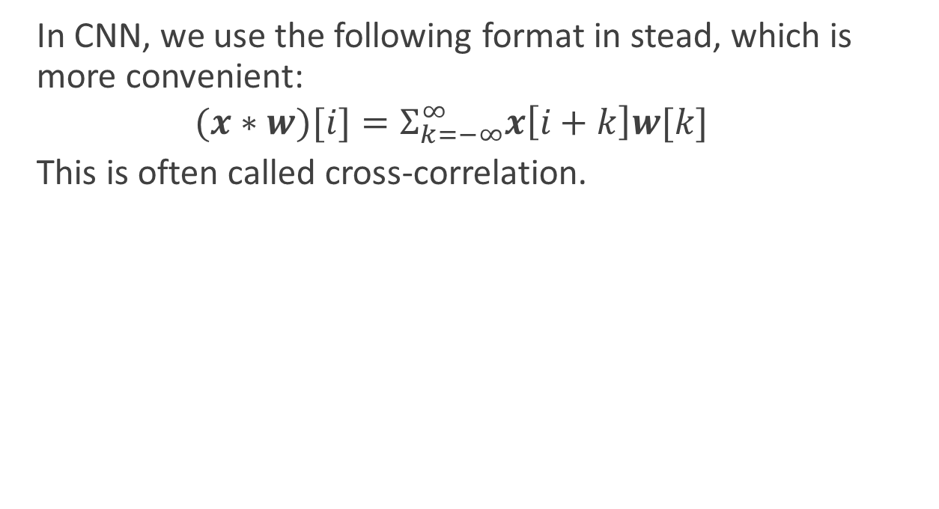
Convolution
In CNN, we use the following format in stead, which is more convenient:
$$(x∗w)[i]=Σ_{k=−∞}^{∞}x\left[i+k\right]w[k]$$
This is often called cross-correlation.

Slide 10
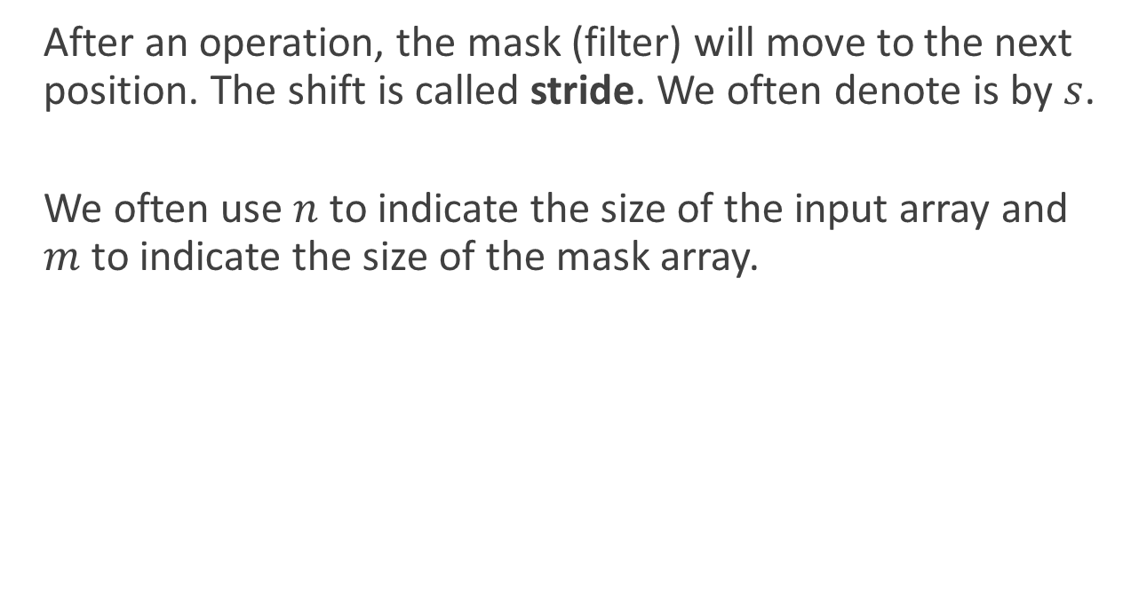
Stride
After an operation, the mask (filter) will move to the next position. The shift is called stride. We often denote is by $s$.
We often use $n$ to indicate the size of the input array and $m$ to indicate the size of the mask array.

Slide 11
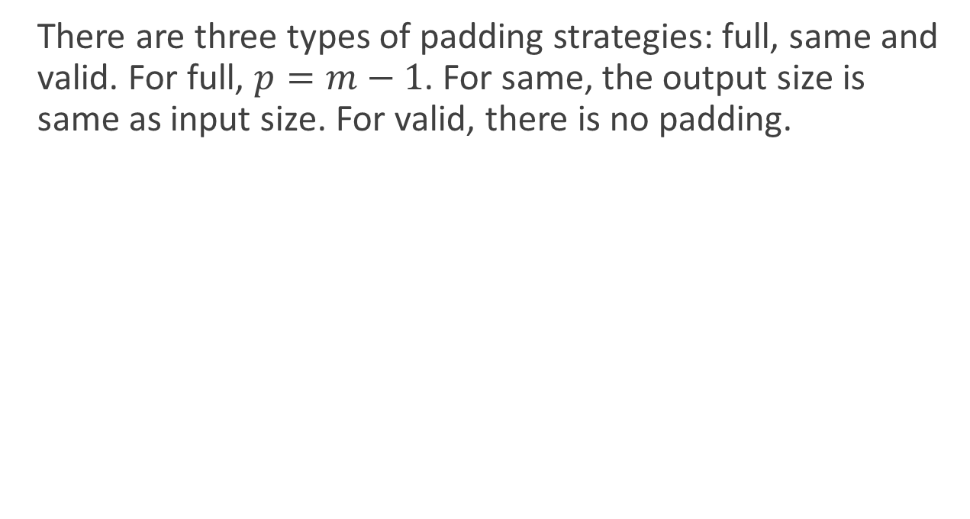
Padding
There are three types of padding strategies: full, same and valid. For full, $p=m−1$. For same, the output size is same as input size. For valid, there is no padding.

Slide 12
Convolution
These are the network parameters to be learned.
1 | -1 | -1
-1 | 1 | -1
-1 | -1 | 1
1 | 0 | 0 | 0 | 0 | 1
0 | 1 | 0 | 0 | 1 | 0
0 | 0 | 1 | 1 | 0 | 0
1 | 0 | 0 | 0 | 1 | 0
0 | 1 | 0 | 0 | 1 | 0
0 | 0 | 1 | 0 | 1 | 0
Filter 1
-1 | 1 | -1
-1 | 1 | -1
-1 | 1 | -1
Filter 2
……
6 x 6 image
Each filter detects a small pattern (3 x 3).

Slide 13
Convolution
1 | -1 | -1
-1 | 1 | -1
-1 | -1 | 1
Filter 1
stride=1
1 | 0 | 0 | 0 | 0 | 1
0 | 1 | 0 | 0 | 1 | 0
0 | 0 | 1 | 1 | 0 | 0
1 | 0 | 0 | 0 | 1 | 0
0 | 1 | 0 | 0 | 1 | 0
0 | 0 | 1 | 0 | 1 | 0
Dot
product
3
-1
6 x 6 image

Slide 14
Convolution
1 | -1 | -1
-1 | 1 | -1
-1 | -1 | 1
Filter 1
If stride=2
1 | 0 | 0 | 0 | 0 | 1
0 | 1 | 0 | 0 | 1 | 0
0 | 0 | 1 | 1 | 0 | 0
1 | 0 | 0 | 0 | 1 | 0
0 | 1 | 0 | 0 | 1 | 0
0 | 0 | 1 | 0 | 1 | 0
3
-3
6 x 6 image

Slide 15
Convolution
1 | -1 | -1
-1 | 1 | -1
-1 | -1 | 1
Filter 1
stride=1
1 | 0 | 0 | 0 | 0 | 1
0 | 1 | 0 | 0 | 1 | 0
0 | 0 | 1 | 1 | 0 | 0
1 | 0 | 0 | 0 | 1 | 0
0 | 1 | 0 | 0 | 1 | 0
0 | 0 | 1 | 0 | 1 | 0
3
-1
-3
-1
-3
1
0
-3
-3
-3
0
1
3
-2
-2
-1
6 x 6 image

Slide 16
Convolution
-1 | 1 | -1
-1 | 1 | -1
-1 | 1 | -1
Filter 2
stride=1
Repeat this for each filter
1 | 0 | 0 | 0 | 0 | 1
0 | 1 | 0 | 0 | 1 | 0
0 | 0 | 1 | 1 | 0 | 0
1 | 0 | 0 | 0 | 1 | 0
0 | 1 | 0 | 0 | 1 | 0
0 | 0 | 1 | 0 | 1 | 0
3
-1
-3
-1
-1
-1
-1
-1
-3
1
0
-3
-1
-1
-2
1
Feature
Map
-3
-3
0
1
-1
-1
-2
1
3
-2
-2
-1
6 x 6 image
-1
0
-4
3
Two 4 x 4 images
Forming 2 x 4 x 4 matrix

Slide 17
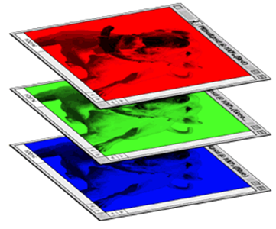
Color image: RGB 3 channels
1 | -1 | -1
-1 | 1 | -1
-1 | -1 | 1
-1 | 1 | -1
-1 | 1 | -1
-1 | 1 | -1
1 | -1 | -1
-1 | 1 | -1
-1 | -1 | 1
-1 | 1 | -1
-1 | 1 | -1
-1 | 1 | -1
1 | -1 | -1
-1 | 1 | -1
-1 | -1 | 1
-1 | 1 | -1
-1 | 1 | -1
-1 | 1 | -1
Filter 1
Filter 2
Color image
1 | 0 | 0 | 0 | 0 | 1
0 | 1 | 0 | 0 | 1 | 0
0 | 0 | 1 | 1 | 0 | 0
1 | 0 | 0 | 0 | 1 | 0
0 | 1 | 0 | 0 | 1 | 0
0 | 0 | 1 | 0 | 1 | 0
1 | 0 | 0 | 0 | 0 | 1
0 | 1 | 0 | 0 | 1 | 0
0 | 0 | 1 | 1 | 0 | 0
1 | 0 | 0 | 0 | 1 | 0
0 | 1 | 0 | 0 | 1 | 0
0 | 0 | 1 | 0 | 1 | 0
1 | 0 | 0 | 0 | 0 | 1
0 | 1 | 0 | 0 | 1 | 0
0 | 0 | 1 | 1 | 0 | 0
1 | 0 | 0 | 0 | 1 | 0
0 | 1 | 0 | 0 | 1 | 0
0 | 0 | 1 | 0 | 1 | 0

Slide 18


The whole CNN
cat dog ……
Convolution
Max Pooling
Can repeat many times
Fully Connected Feedforward network
Convolution
Max Pooling
Flattened

Slide 19
Max Pooling
1 | -1 | -1
-1 | 1 | -1
-1 | -1 | 1
-1 | 1 | -1
-1 | 1 | -1
-1 | 1 | -1
Filter 1
Filter 2
3
-1
-3
-1
-1
-1
-1
-1
-3
1
0
-3
-1
-1
-2
1
-3
-3
0
1
-1
-1
-2
1
3
-2
-2
-1
-1
0
-4
3

Slide 20


Why Pooling
Subsampling pixels will not change the object
bird
bird
Subsampling
We can subsample the pixels to make image smaller
fewer parameters to characterize the image

Slide 21
Max Pooling
New image
but smaller
1 | 0 | 0 | 0 | 0 | 1
0 | 1 | 0 | 0 | 1 | 0
0 | 0 | 1 | 1 | 0 | 0
1 | 0 | 0 | 0 | 1 | 0
0 | 1 | 0 | 0 | 1 | 0
0 | 0 | 1 | 0 | 1 | 0
Conv
3
0
-1
1
Max
Pooling
3
1
0
3
2 x 2 image
6 x 6 image
Each filter
is a channel

Slide 22
The whole CNN
3
0
-1
1
Convolution
3
1
0
3
Max Pooling
Can repeat many times
A new image
Convolution
Smaller than the original image
The number of channels is the number of filters
Max Pooling

Slide 23
The whole CNN
cat dog ……
Convolution
Max Pooling
Fully Connected Feedforward network
A new image
Convolution
Max Pooling
Flattened
A new image

Slide 24
Flattening
3
0
1
3
0
-1
1
3
3
1
-1
0
3
Flattened
1
Fully Connected Feedforward network
0
3

Slide 25
Only modified the network structure and input format (vector -> 3-D tensor)
input
Convolution
1 | -1 | -1
-1 | 1 | -1
-1 | -1 | 1
-1 | 1 | -1
-1 | 1 | -1
-1 | 1 | -1
There are 32 5x5 filters.
……
Max Pooling
Input_shape = ( 28 , 28 , 1)
28 x 28 pixels
1: black/white, 3: RGB
Convolution
3
-1
3
Max Pooling
-3
1

Slide 26
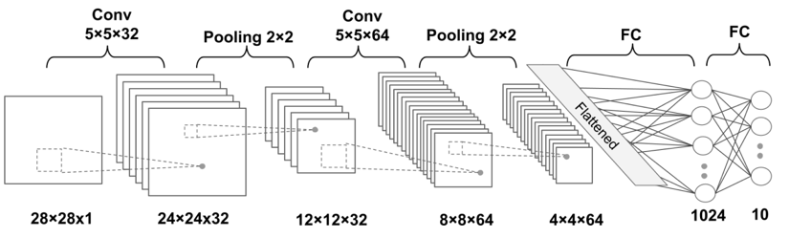
Structure of the CNN model

Slide 27
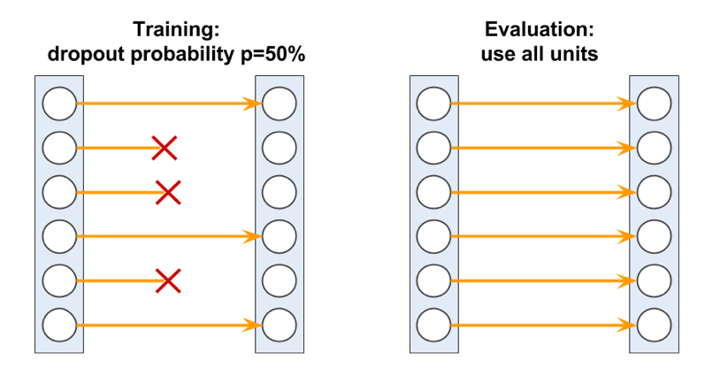
Dropout Layer
Dropout is a technique to fight overfitting. We randomly dropout some connections while training but use all units while evaluate models.

Slide 28
Challenge of Deep Networks
In theory, deep networks may work better than shallow network, However, in practical, deep networks are much harder to be trained.

Slide 29
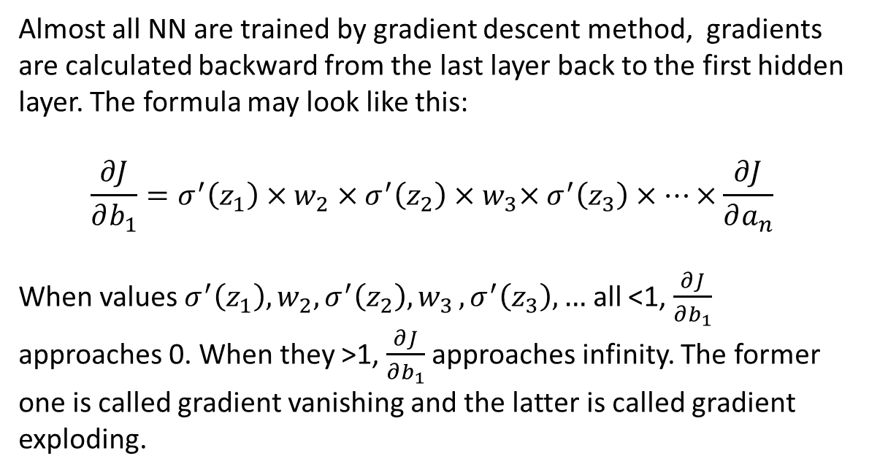
Vanishing/Exploding gradients
Almost all NN are trained by gradient descent method, gradients are calculated backward from the last layer back to the first hidden layer. The formula may look like this:
$$\frac{∂J}{∂b_{1}}=σ^{′}\left(z_{1}\right)×w_{2}×σ^{′}\left(z_{2}\right){×w}_{3}×σ^{′}\left(z_{3}\right)×⋯×\frac{∂J}{∂a_{n}}$$
When values $σ^{′}\left(z_{1}\right),w_{2},σ^{′}\left(z_{2}\right){,w}_{3},σ^{′}\left(z_{3}\right), …$ all <1, $\frac{∂J}{∂b_{1}}$ approaches 0. When they >1, $\frac{∂J}{∂b_{1}}$ approaches infinity. The former one is called gradient vanishing and the latter is called gradient exploding.

Slide 30
Vanishing/Exploding gradients
Gradient vanishing and gradient exploding make the train of deep network very hard.
Gradient exploding can be eased by gradient clipping. That means if the gradient is greater than a predefined limit, say 1000, we set it to that limit. So the gradient will never exceed that limit.
Gradient vanishing is much harder to deal with.

Slide 31
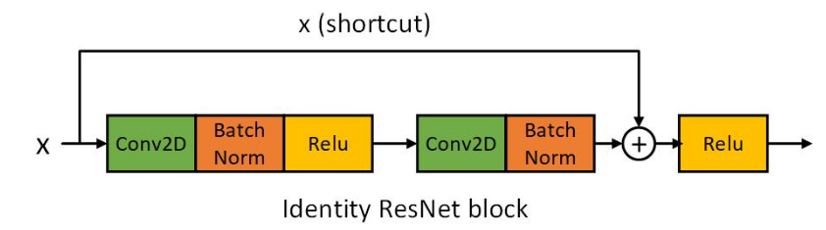
Batch Normalization and Shortcut
Several methods can be used to ease the gradient vanish problem.
Using different activation function, such as RELU.
Batch normalization
Shortcut (ResNet use this strategy).
Different initialization strategies (example: Xavier initialization)

Slide 32
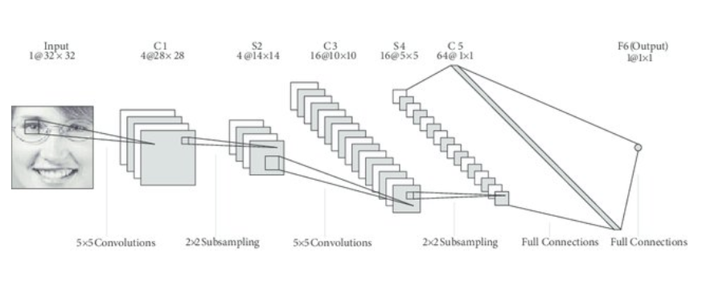
Deep Network Samples - LeNet
LeNet-5 is pioneering 7-level convolutional network by LeCun et al. in 1998, that classifies digits, was applied by several banks to recognize hand-written numbers on checks digitized in 32x32 pixel images. The ability to process higher resolution images requires larger and more layers of convolutional neural networks, so this technique is constrained by the availability of computing resources.

Slide 33
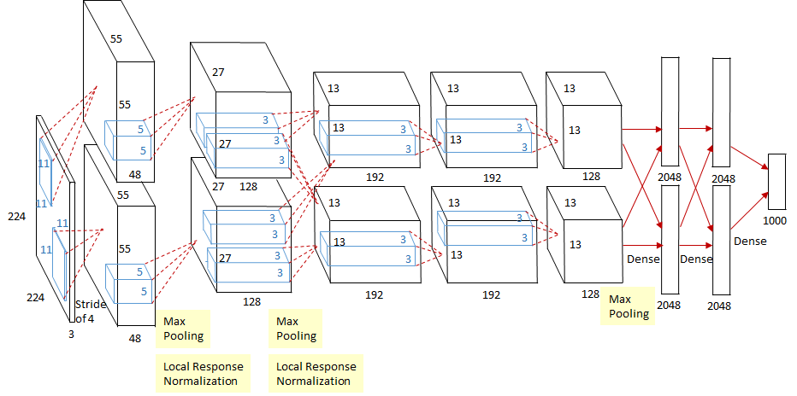
Deep Network Samples - AlexNet
AlexNet is a CNN designed by Alex Krizhevsky, and published with Ilya Sutskever and Krizhevsky's PhD advisor Geoffrey Hintonwho was originally resistant to the idea of his student. AlexNet competed in the ImageNet Large Scale Visual Recognition Challenge on September 30, 2012. The network achieved a top-5 error of 15.3%, more than 10.8 percentage points lower than that of the runner up.

Slide 34
Deep Network Samples - AlexNet
AlexNet has 7 hidden layers, 650K neurons, 62.3 million parameters, in which 3.7 million (6%) are in convolution layers and 58.6 million (94%) are in FC layers.
The highlights of the paper:
Use Relu instead of Tanh to add non-linearity. It accelerates the speed by 6 times at the same accuracy.
Use dropout instead of regularisation to deal with overfitting. However the training time is doubled with the dropout rate of 0.5.
Overlap pooling to reduce the size of network. It reduces the top-1 and top-5 error rates by 0.4% and 0.3%, repectively.
Copy convolution layers into different GPUs; Distribute the fully connected layers into different GPUs.
Feed one batch of training data into convolutional layers for every GPU (Data Parallel).
Feed the results of convolutional layers into the distributed fully connected layers batch by batch (Model Parallel) When the last step is done for every GPU. Backpropogate gradients batch by batch and synchronize the weights of the convolutional layers.

Slide 35
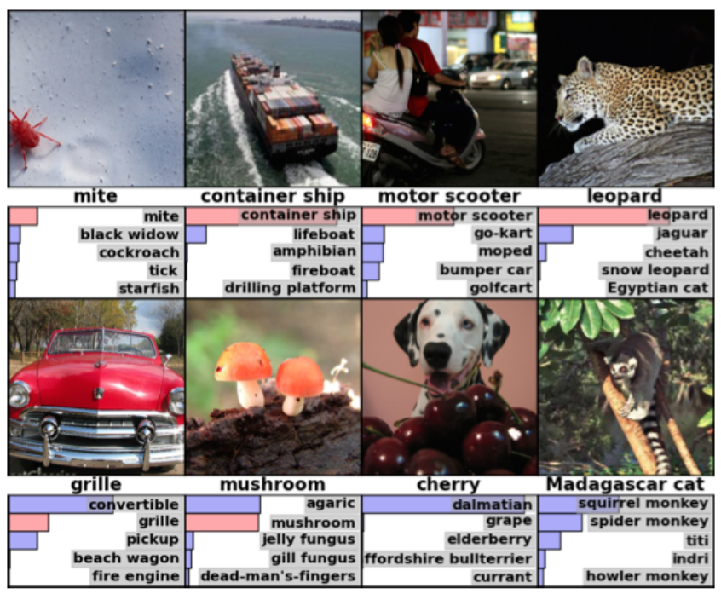
Eight ILSVRC-2010 test images

Slide 36
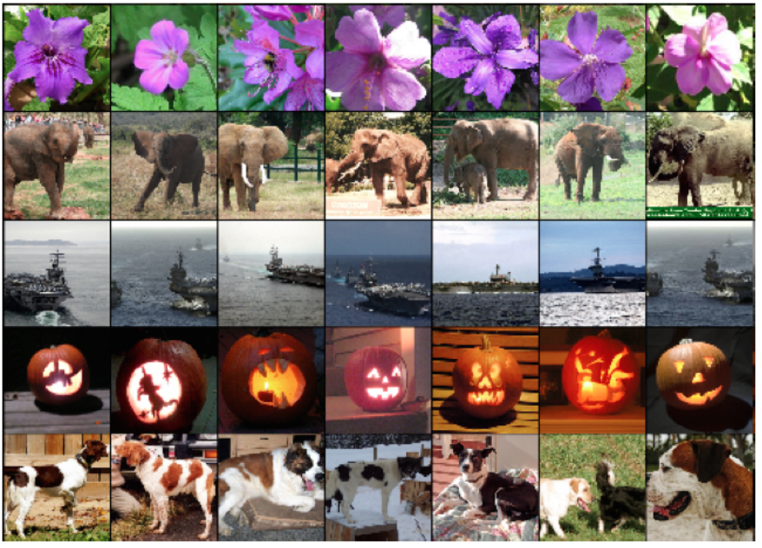
Five ILSVRC-2010 test images

Slide 37
Deep Network Samples - VGG
VGG16 is a convolutional neural network model proposed by K. Simonyan and A. Zisserman from the University of Oxford in the paper “Very Deep Convolutional Networks for Large-Scale Image Recognition”. The model achieves 92.7% top-5 test accuracy in ImageNet, which is a dataset of over 14 million images belonging to 1000 classes. It was one of the famous model submitted to ILSVRC-2014. It makes the improvement over AlexNet by replacing large kernel-sized filters (11 and 5 in the first and second convolutional layer, respectively) with multiple 3×3 kernel-sized filters one after another. VGG16 was trained for weeks and was using NVIDIA Titan Black GPU’s.
Pretrained VGG models are available online and you can use it as a start point.

Slide 38
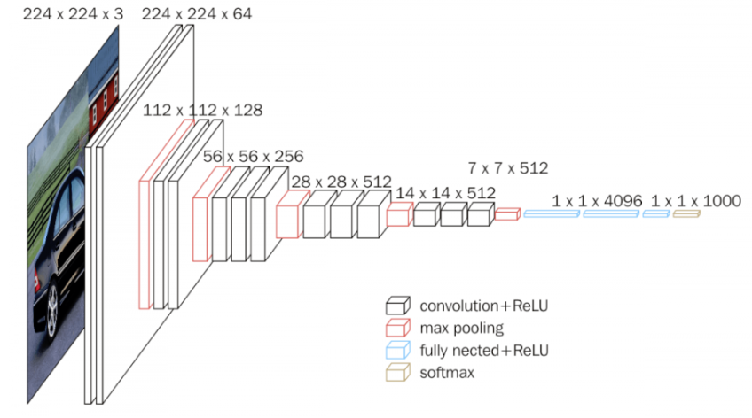
Deep Network Samples - VGG

Slide 39
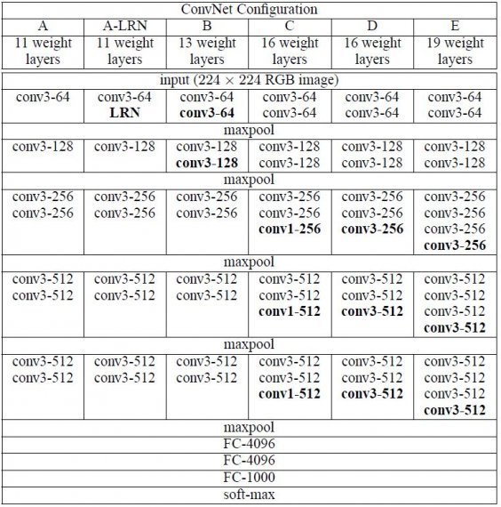
Deep Network Samples - VGG

Slide 40
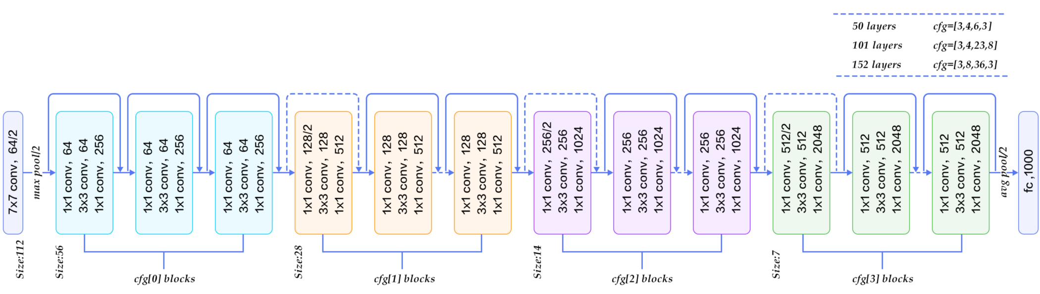
Deep Network Samples - ResNet
ResNet is the Convolutional Neural Networks developed by Microsoft team that won ILSRVC 2015 competition and surpass the human performance on ImageNet dataset.

Slide 41
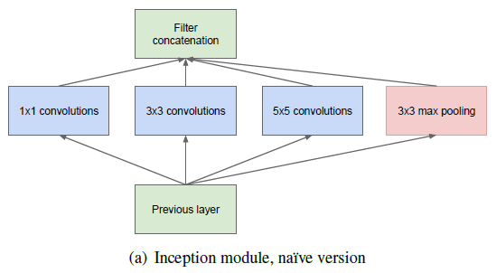
Deep Network Samples – GoogLeNet
GoogLeNet is the winner of the ILSVRC contest 2014. It is also called Inception Net. It consists of many Inception Modules:

Slide 42
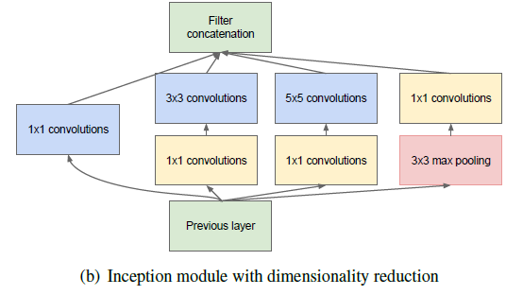
Deep Network Samples – GoogLeNet

Slide 43
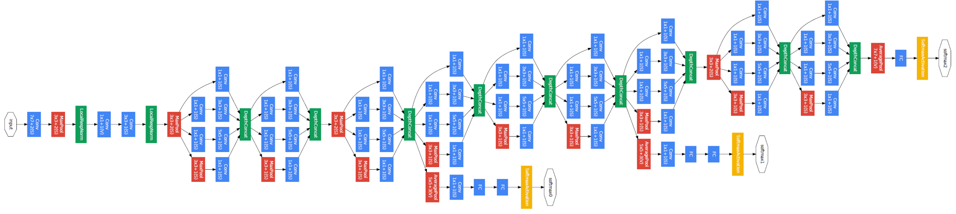
Deep Network Samples – GoogLeNet

Slide 44
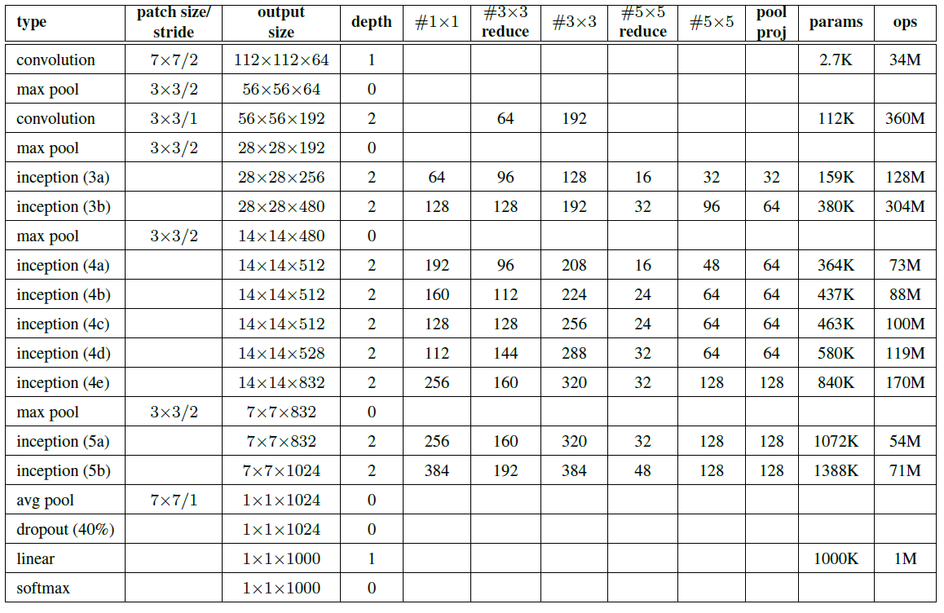
Deep Network Samples – GoogLeNet
There are 22 layers in total.

Slide 45
Recurrent Neural Network

Slide 46
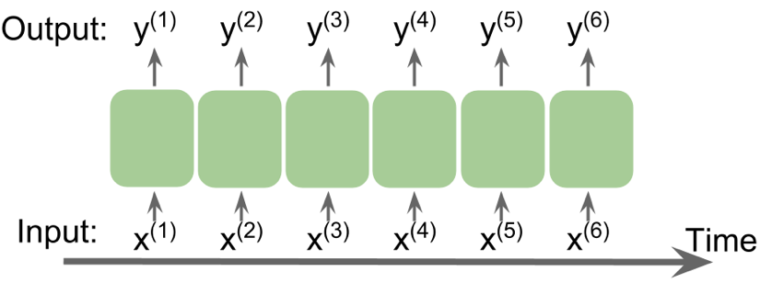
Recurrent Neural Networks
Recurrent Neural Networks (RNN) are a family of neural networks for processing sequential data.
Example of Sequential Data:
Audio
Video
Text
Sequences
Time Series Data

Slide 47
Recurrent Neural Networks
Non-sequential data: input is independent and identical distributed (IID)
Sequential data: input data is not independent to each other. it carries time or order information.
Time-series data is a special type of sequential data.
Not all sequential data is time-series data.
We use $<x^{\left(1\right)},x^{\left(2\right)},…,x^{\left(T\right)}>$ to represent sequence of data. $x^{\left(t\right)}$ , $y^{\left(t\right)}$ represent the data at time $t$.

Slide 48

Recurrent Neural Networks
Types of RNN Models:

Slide 49
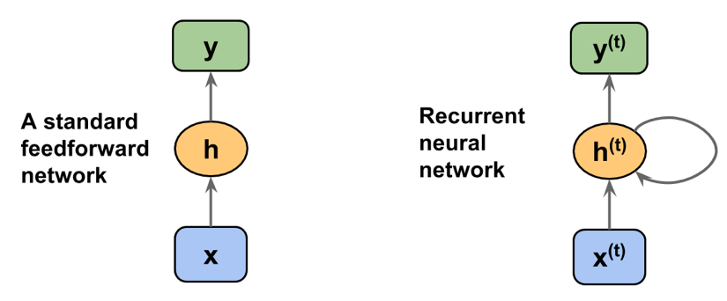
Recurrent Neural Networks
Compare standard NNs and RNNs:

Slide 50
Recurrent Neural Networks
Typically, a recurrent layer can return the a sequence as output:
$$<o^{\left(1\right)},o^{\left(2\right)},…,o^{\left(T\right)}>$$
For many one model, we simply output $o^{\left(T\right)}$.

Slide 51
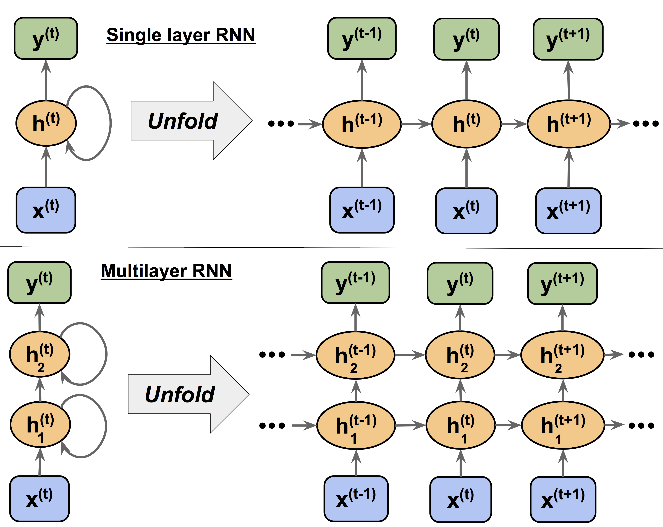
Recurrent Neural Networks
Unfold RNNs:

Slide 52
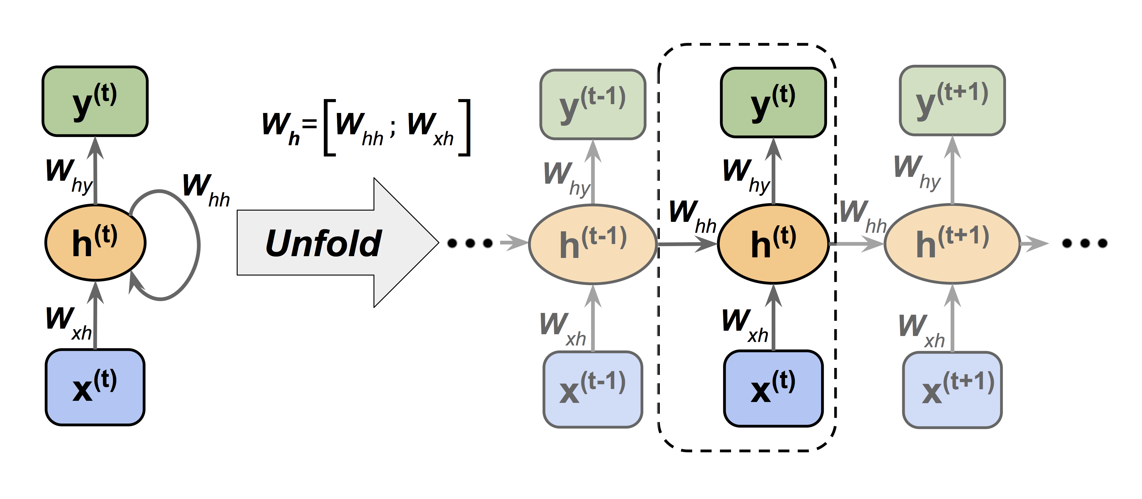
Recurrent Neural Networks
Structure of RNNs:

Slide 53
Challenge of RNN
Because of the multiplicative factor, $\frac{∂h^{\left(t\right)}}{∂h^{\left(k\right)}}=Π_{i=k+1}^{t}\frac{∂h^{\left(i\right)}}{∂h^{\left(i−1\right)}}$ , in computing the gradients of a loss function, the so-called vanishing and exploding gradient problems arise.
If $\frac{∂h^{\left(i\right)}}{∂h^{\left(i−1\right)}}<1$, $Π_{i=k+1}^{t}\frac{∂h^{\left(i\right)}}{∂h^{\left(i−1\right)}}→0$
If $\frac{∂h^{\left(i\right)}}{∂h^{\left(i−1\right)}}>1$, $Π_{i=k+1}^{t}\frac{∂h^{\left(i\right)}}{∂h^{\left(i−1\right)}}→∞$

Slide 54
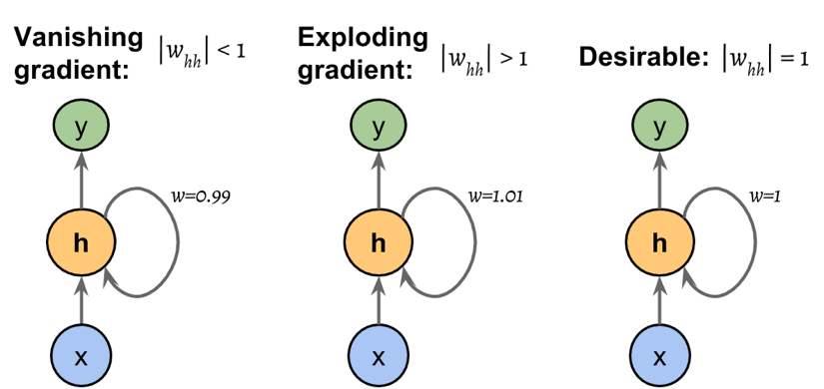
Challenge of RNN

Slide 55
Challenge of RNN
In practice, there are at least three solutions to this problems.
Gradient clipping: if the gradient exceeds a preset limit, set the gradient to that limit.
TBPTT: Limit the number of time steps that the signal can backpropagate.
LSTM

Slide 56
LSTM
Long Short-Term Memory (LSTM) were first introduced to overcome the vanishing gradient problem.
The building block of an LSTM is a memory cell, which essentially represents or replaces the hidden layer of standard RNNs.

Slide 57
LSTM
In an LSTM cell, there are three different types of gates, which are known as the forget gate, the input gate, and the output gate:
The forget gate ( $f_{t}$ ) allows the memory cell to reset the cell state without growing indefinitely. It decides which information is allowed to go through and which information to suppress.
$$f_{t} = σ(W_{xf}x^{\left(t\right)} + W_{hf}h^{\left(t−1\right)} + b_{f})$$

Slide 58
LSTM
The input gate ($i_{t}$ ) and candidate value (${\tilde{C}}_{t}$ ) are responsible for updating the cell state. They are computed as follows:
$$i_{t} = σ(W_{xi}x^{\left(t\right)} + W_{hi}h^{\left(t−1\right)} + b_{i})$$
$${\tilde{C}}_{t} =tanh(W_{xc}x^{\left(t\right)} + W_{hc}h^{(t−1)} + b_{c})$$
The cell state at time t is computed as follows:
$$C^{\left(t\right)} = (C^{\left(t−1\right)} ⊙ f_{t}) ⨁ (i_{t} ⊙{\tilde{C}}_{t})$$
$σ$ is the sigmoid function and ⊙ refers to the element-wise product.

Slide 59
LSTM
The output gate ($o_{t}$ ) decides how to update the values of hidden units:
$$o_{t} = σ(W_{xo}x^{\left(t\right)} + W_{ho}h^{\left(t−1\right)} + b_{o})$$
The hidden units at the current time step are computed as follows:
$$h^{\left(t\right)} = o_{t} ⊙ tanh⁡(C^{\left(t\right)})$$

Slide 60
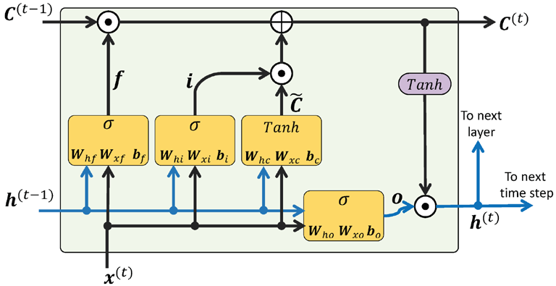
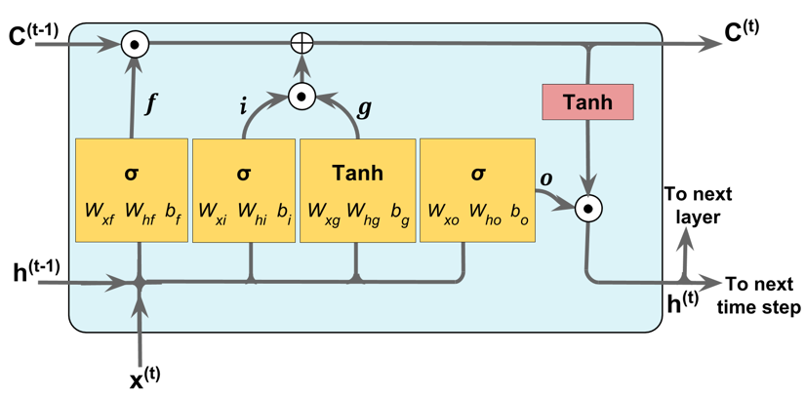
LSTM

Slide 61
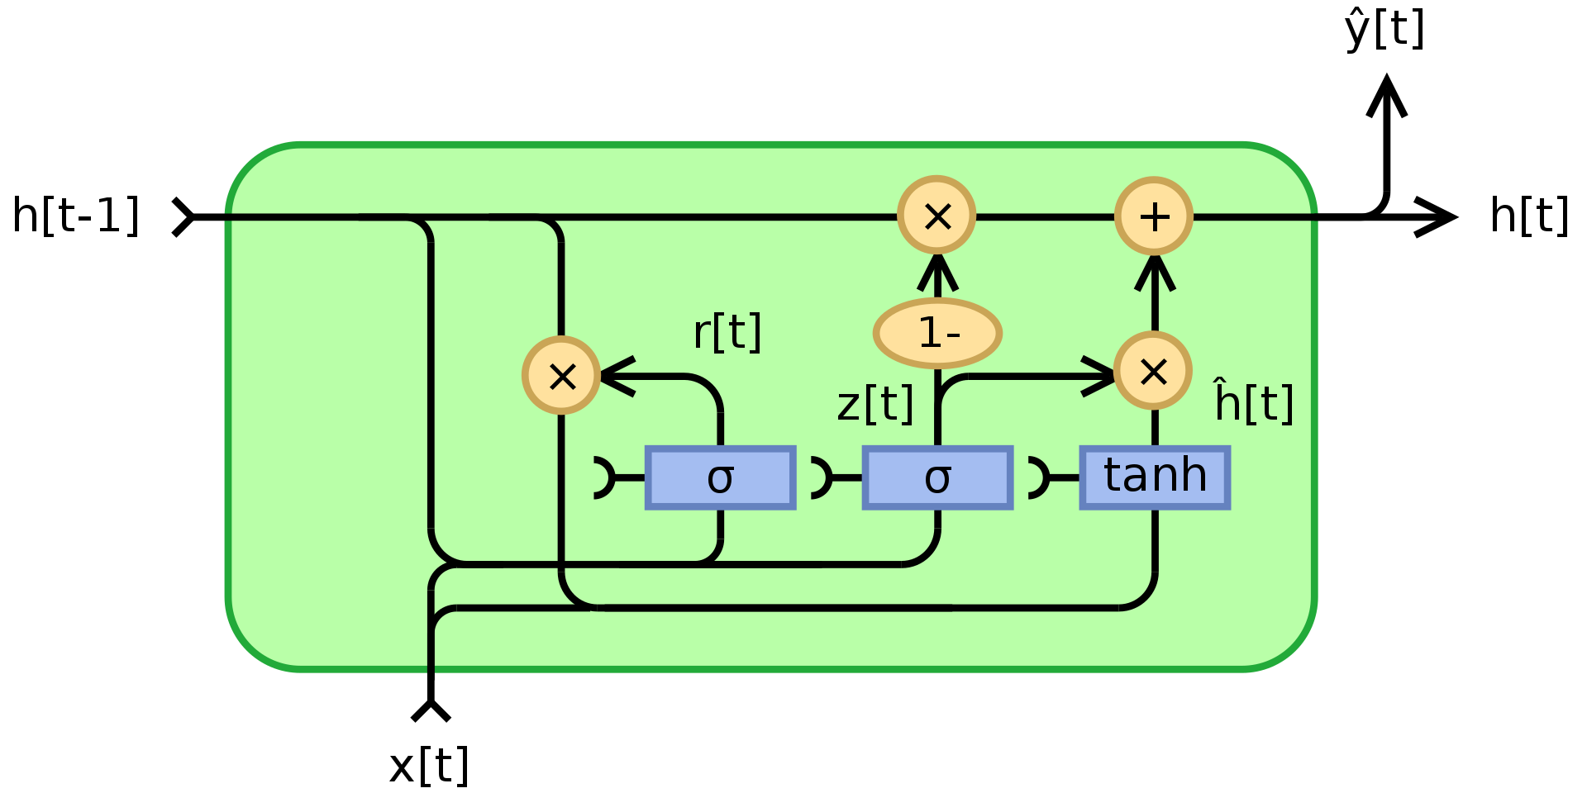
Other advanced RNN models
Gated Recurrent Unit (GRU) is a simpler architecture than LSTM.

Slide 62
Large Language Models

Slide 63
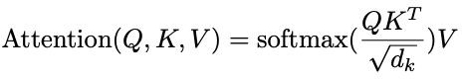




Scaled Dot Product Attention
Key algorithm in transformers
Attention weights: how likely each query
matches key (used for weighted sum of values)
Dividing by d_{k} makes algorithm easier to train
input consists of queries and keys of dimension dk, and values of dimension d
Queries packed into matrix Q
The keys and values are also packed together into matrices K and V .
prevents binary prediction of one 1 and a whole bunch of zeros
helps the gradients flow
queries keys
values
outputs
then can take loss, backpropagate, update the weights and values
NOT stepping through a sequence like with a RNN
.
=
softmax
Inputs
Wq
sqrt(num dimensions in key)
In
Robotics
Today
…
Wk
Wv

Slide 64
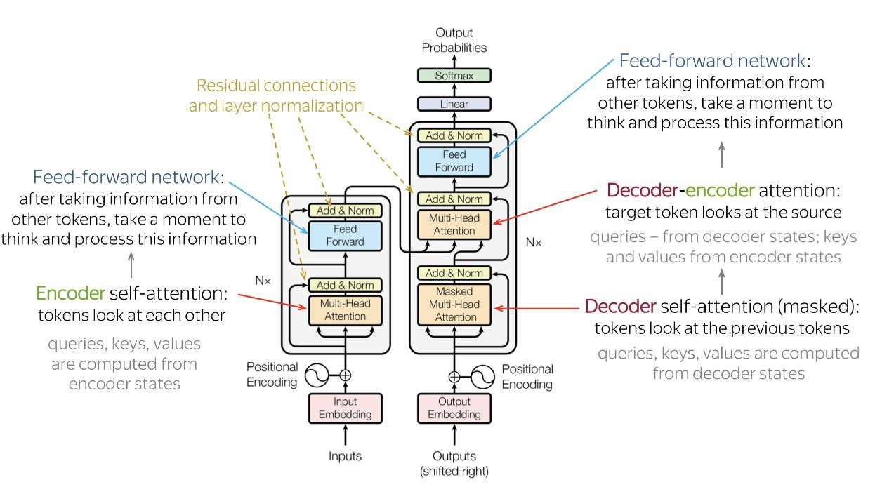
Full-Architecture

Slide 65
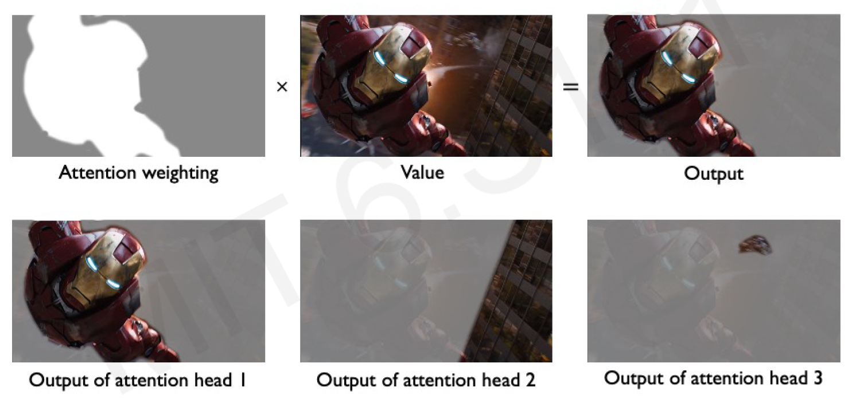
Applying Multiple Self-Attention Heads

Slide 66
Large Language Models
What are Large Language Models (LLMs)?
Advanced AI systems that understand and generate human language.
Large:
Trained on massive datasets of text and code.
Utilize very large neural networks with billions of parameters.
Revolutionized how computers process language.
Built using deep learning techniques.
Perform a wide array of language-based tasks:
Writing creative content
Translating languages
Answering complex questions
Generating code
Large Multimodal Models (LMMs).

Slide 67
Large Language Models
What are Large Language Models (LLMs)?
Technically, LLMs are trained to:
Assigns probabilities to sequences of words
Generate text by sampling possible next words
Are trained by learning to guess the next word
Even through pretrained only to predict words, they learn a lot of useful language knowledge,
Since trained on a lot of text

Slide 68
Three architectures for large language models
Decoders | Encoders | Encoder-decoders
GPT, Claude, Llama | BERT family, HuBERT | T5, Whisper
Mixtral

Slide 69
Encoders
Many varieties!
Popular: Masked Language Models (MLMs)
BERT family
Trained by predicting words from surrounding words on both sides
Are usually finetuned (trained on supervised data) for classification tasks.

Slide 70
Encoder-Decoders
Trained to map from one sequence to another
Very popular for:
machine translation (map from one language to another)
speech recognition (map from acoustics to words)

Slide 71
Decoder-only models
Also called:
Causal LLMs
Autoregressive LLMs
Left-to-right LLMs
Predict words left to right

Slide 72

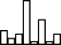




Conditional Generation: Generating text conditioned on previous text!
Completion Text
all
the
Language Modeling Head
Softmax
Unencoder layer
logits
U
U
Transformer Blocks
…
…
Encoder
+
E
i
+
E
i
+
E
i
+
E
i
+
E
i
+
E
i
+
E
i
So
long
and
thanks for
all
the
Prefix Text

Slide 73
Many practical NLP tasks can be cast as word prediction!
Sentiment analysis: “I like Jackie Chan”
We give the language model this string: The sentiment of the sentence "I like Jackie Chan" is:
And see what word it thinks comes next:
P(positive|The sentiment of the sentence ‘‘I like Jackie Chan" is:)
P(negative|The sentiment of the sentence ‘‘I like Jackie Chan" is:)

Slide 74
Framing lots of tasks as conditional generation
QA: “Who wrote The Origin of Species”
We give the language model this string:
Q: Who wrote the book ‘‘The Origin of Species"? A:
And see what word it thinks comes next:
P(w|Q: Who wrote the book ‘‘The Origin of Species"? A:)
And iterate:
P(w|Q: Who wrote the book ‘‘The Origin of Species"? A: Charles)

Slide 75
Summarization
The only thing crazier than a guy in snowbound Massachusetts boxing up the powdery white stuff and offering it for sale online? People are actually buying it. For $89, self-styled entrepreneur Kyle Waring will ship you 6 pounds of Boston-area snow in an insulated Styrofoam box – enough for 10 to 15 snowballs, he says.
Original
But not if you live in New England or surrounding states. “We will not ship snow to any states in the northeast!” says Waring’s website, ShipSnowYo.com. “We’re in the business of expunging snow!”
His website and social media accounts claim to have filled more than 133 orders for snow – more than 30 on Tuesday alone, his busiest day yet. With more than 45 total inches, Boston has set a record this winter for the snowiest month in its history. Most residents see the huge piles of snow choking their yards and sidewalks as a nuisance, but Waring saw an opportunity.
According to Boston.com, it all started a few weeks ago, when Waring and his wife were shov- eling deep snow from their yard in Manchester-by-the-Sea, a coastal suburb north of Boston. He joked about shipping the stuff to friends and family in warmer states, and an idea was born. [...]
Summary
Kyle Waring will ship you 6 pounds of Boston-area snow in an insulated Styrofoam box – enough for 10 to 15 snowballs, he says. But not if you live in New England or surrounding states.

Slide 76








LLMs for summarization (using tl;dr)
Generated Summary
Kyle
Waring
will
…
LM Head
U
U
U
…
E
E
E
E
E
E
E
E
The
only
…
idea
was
born.
tl;dr
Kyle
Waring
will
Original Story
Delimiter

Slide 77
Large Language Model Training
Typical Training Steps of LLMs:
Pre-training: Training the model on the preprocessed data to learn language patterns and relationships.
Fine-tuning: Adapting the pre-trained model for specific tasks using smaller, labeled datasets.
Reinforcement Learning: Further refining the model's responses based on human feedback or reward signals to improve helpfulness, safety, and alignment with human values.

Slide 78
Pretraining
We just train them to predict the next word!
Take a corpus of text
At each time step t
ask the model to predict the next word
train the model using gradient descent to minimize the error in this prediction
"Self-supervised" because it just uses the next word as the label!

Slide 79
Intuition of language model training: loss
Same loss function: cross-entropy loss
We want the model to assign a high probability to true word w
• = want loss to be high if the model assigns too low a probability to w
CE Loss: The negative log probability that the model assigns to the true next word w
If the model assigns too low a probability to w
We move the model weights in the direction that assigns a higher probability to w

Slide 80


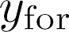

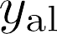

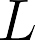








Training a transformer language model
Next token
long and thanks for all
…
… =
Loss
- log y_{and}
- log ythanks
Language Modeling Head
logits
U
logits
U
logits
U
logits
U
logits
U
…
Stacked Transformer Blocks
…
…
…
…
…
…
x1
x2
+
E
x3
+
E
x4
+
E
x5
+
E
…
+
E
1
2
3
4
5
Input Encoding
…
Input tokens
So
long
and
thanks
for

Slide 81
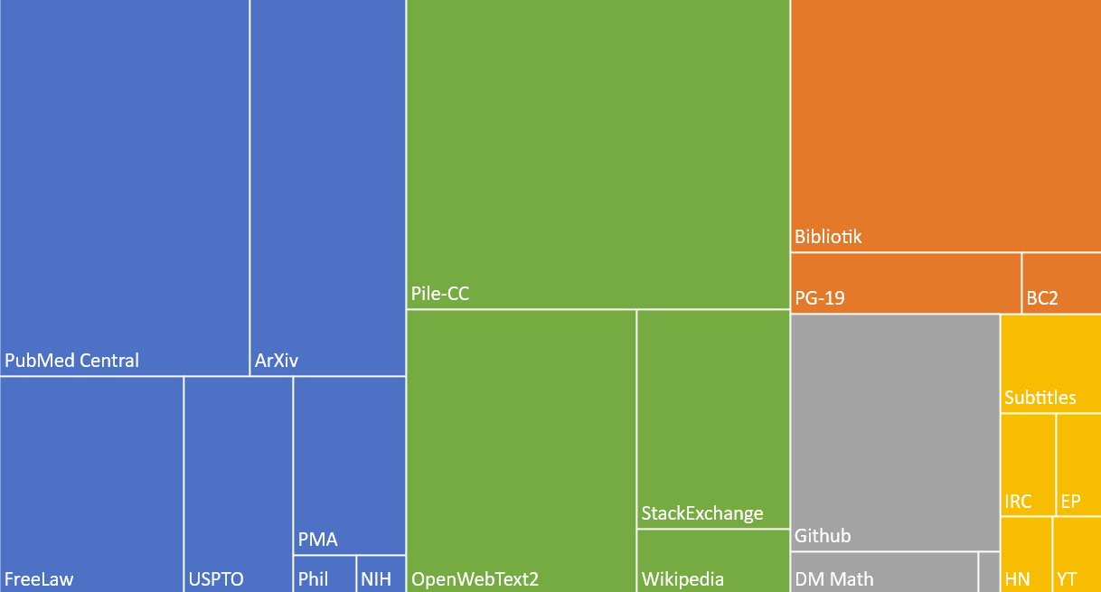
The Pile: a pretraining corpus
academics web
books
dialog

Slide 82
Filtering for quality and safety
Quality is subjective
Many LLMs attempt to match Wikipedia, books, particular websites
Need to remove boilerplate, adult content
Deduplication at many levels (URLs, documents, even lines) Safety also subjective
Toxicity detection is important, although that has mixed results
Can mistakenly flag data written in dialects like African American English

Slide 83
Finetuning for daptation to new domains
What happens if we need our LLM to work well on a domain it didn't see in pretraining?
Perhaps some specific medical or legal domain?
Or maybe a multilingual LM needs to see more data on some language that was rare in pretraining?

Slide 84








Finetuning
Fine- tuning Data
Pretraining Data
Pretrained LM
Fine-tuned LM
… … …
… … …
Pretraining
Fine-tuning

Slide 85
Fine Turning
Fine-tuning Methods:Supervised Fine-tuning: Training the model on a labeled dataset specific to the target task.
Few-shot Learning: Providing a small set of examples to guide the model's learning for a specific task.
Transfer Learning: Leveraging knowledge from a pre-trained model to improve performance on a related task.
Hyperparameter Tuning: Optimizing the model's settings (e.g., learning rate) to improve performance on a specific task.

Slide 86
Finetuning as "continued pretraining" on new data
Further train all the parameters of model on new data
using the same method (word prediction) and loss function (cross-entropy loss) as for pretraining.
as if the new data were at the tail end of the pretraining data
Hence sometimes called continued pretraining

Slide 87
Reinforcement Learning
A critical step in aligning LLMs with human preferences and ethical guidelines.
Involves training the model to make decisions that maximize a reward signal.
This reward signal is often derived from human feedback, indicating the desired qualities of the LLM's output (e.g., helpfulness, harmlessness).
Helps to address issues like:
Bias
Toxicity
Hallucinations
Unsafe or undesirable behavior

Slide 88
Thank you!

